Slide 1

Module III-B:
USNC/IEC Personnel
Roles and Responsibilities

Slide 2

Module III-B: Learning Objectives
This module provides an overview of committee personnel working within the U.S. National Committee of the International Electrotechnical Commission (USNC/IEC)
  Responsibilities
  Appointment
  Qualifications

Slide 3
Module III-B: Disclaimer
The information contained in this self-taught
learning module is intended as a summary of documents and procedures frequently used within the IEC and the USNC/IEC.
For additional information about content addressed in this module, please contact the USNC/IEC Staff (usnc@ansi.org).
Additional information is also available via ANSI Education and Training Services.

Slide 4
Reference Materials &
Source Documents
ISO/IEC Directives, Part 1: 2017
Procedures for the technical work
ISO/IEC Directives, Part 2: 2016
Rules for the structure and drafting of International Standards
ISO/IEC Directives, Part 1:2017 + IEC Supplement:2017
Procedures specific to IEC
IEC Statutes and Rules of Procedures
IEC membership and participation procedures
USNC Statutes and Rules of Procedure: 2005
Model Operating Procedures for USNC/IEC TAGS: 2014
Guide for U.S. Delegates to meetings of ISO and the IEC

Slide 5
Providing Leadership and Guidance for USNC Technical Activities
USNC Members
USNC/IEC Officers
USNC/IEC Council Members
Conformity Assessment Policy Coordinating Committee (CAPCC)
  USNC/IECEE
  USNC/IECEx
  USNC/IECQ
  USNC/IECRE
Technical Management Committee (TMC)
  Group Managers
  Technical Advisors
  Deputy Technical Advisors
  TAG Administrator
  TAG Secretary
  TAG Members
  Experts (WG, PT, MT)

Slide 6
USNC/IEC Members
The broad-based USNC/IEC constituency represents the stakeholders in the U.S. electrotechnical community
  The USNC/IEC includes representatives of academia, consumers, government agencies, manufacturers, professional societies, testing organizations, trade associations and more
ANSI members may become voting members of the USNC upon determination of material interest, provided they are also
  organizations serving as TAG Administrators and/or TC/SC Administrative Secretariats and having paid the requisite fees.
    or
  entities which have expressed interest in participating in the USNC and have paid the USNC Organizational fee.

Slide 7

USNC/IEC Officers
President
Vice President – Technical
Vice President – Conformity Assessment
Vice President – Finance
General Secretary
Past-President
President-Elect

Slide 8
USNC President Responsibilities
National
  Serves as the principal representative of the USNC and chair meetings of the USNC and the USNC Council
  Serves as an ex-officio member, without vote, on USNC Standing Committees
  Serves as spokesperson for the USNC
  Provides overall guidance and direction to the USNC General Secretary in the administration of USNC activities
  Serves on the ANSI Board of Directors and Executive Committee
International / Regional
  Serves as primary point of contact for IEC Central Office with USNC
  Serves as USNC point of contact for groups such as CENELEC, COPANT, PASC, etc.
  Represents the USNC when appointed to groups such as the IEC Council Board and IEC/CENELEC Management Coordination Group
  Leads the U.S. Delegation to IEC General Meetings and Council Meetings

Slide 9

USNC President Term of Office
Elected by the USNC Council for a three (3) year term
  One successive reelection possible
  This may be in addition to any partial term previously served

Slide 10
Vice President – Technical
Responsibilities
National
  Serves as Chair of the USNC Technical Management
  Committee (TMC)
International
  Serves as the USNC’s primary representative to the IEC Standardization Management Board (SMB)
  Represents the USNC President at international and regional meetings that he/she cannot attend

Slide 11
Vice President – Conformity Assessment
Responsibilities
National
  Serves as Chair of the USNC Conformity Assessment Policy Coordinating Committee (CAPCC)
International
  Serves as the USNC’s primary representative to the IEC Conformity Assessment Board (CAB)
  Represents the USNC President at international and regional meetings that he/she cannot attend

Slide 12
Vice President – Finance
Responsibilities
National
  Serves as Chair of the USNC Finance Committee
International
  Serves on the IEC Finance Committee

Slide 13

USNC Vice Presidents Terms of Office
Each of the three
Vice Presidents for
the USNC
  Elected by the USNC Council for a three (3) year term
    One successive reelection possible

Slide 14
General Secretary Responsibilities
Serve as the USNC point of contact on all administrative matters and the
backup point of contact for the USNC President
Ensures the provision of administrative support, including preparation of the minutes of meetings, to the USNC Management Committees
Ensures the availability and control of IEC documents to the relevant USNC participants and the processing of ballots and other communications from the USNC to the IEC
Ensures the collection and disbursement of funds according to the USNC budget
Alerts the appropriate USNC management committee(s) to any unexpected events or issues that might affect their work
Manages assigned USNC staff

Slide 15
General Secretary Term of Office
The USNC General Secretary is an ANSI staff employee who provides support for the USNC.
  The General Secretary, or ANSI staff designee, participates directly in all USNC Policy and Standing Committee meetings, including Officer Meetings, without vote.
  The General Secretary is nominated by the ANSI President and USNC President, and is subject to the approval of the USNC Council.
    The USNC Council may, by a two-thirds (2/3) vote, request replacement of the General Secretary.
As the principal ANSI staff person providing support to the USNC, this person also participates directly in USNC management committee meetings as an ex officio member, without vote

Slide 16
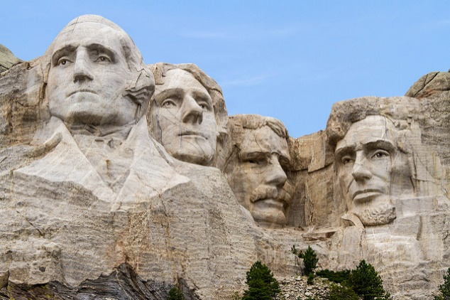
Immediate Past-President
The Immediate Past President
  May be available for special assignments as designed by the President
  Shall have the privilege of the floor at all meetings
  Shall serve as an Officer for two years following the conclusion of his or her term of office, ex-officio, without vote.

Slide 17
President-Elect
Term of Office
  One-year term
  Elected to serve as a voting member of the USNC Council during the outgoing President’s last year in office
  At the end of that year, the President-Elect automatically becomes the USNC President
Responsibilities
  Serves as Vice-Chair of the USNC Council
  Assists the President and performs other activities as requested
  Represents the USNC at international, regional and other meetings when the President cannot attend and upon request

Slide 18
Members of the USNC Council
The Council membership represents all USNC entities
  Voting Representatives:
    The Officers of the USNC
    Elected representatives of organizations administering TAGs and/or Secretariats and from Premier Members
    Elected Government representatives
    An elected consumer advocate
  Ex-officio (non-voting) representatives:
    The Chairs of the Standing Committees not otherwise members of Council
    The President of ANSI
    The Chair of the IPC
    IEC Officers from the US
  The terms of reference of the USNC Council are defined in Module 2 of this training program

Slide 19
USNC Council Member Responsibilities
Representing and coordinating United States involvement in the IEC and other electrotechnical bodies associated with the IEC on behalf of ANSI;
Overseeing the TMC and CAPCC;
Reviewing USNC membership;
Recommending to the ANSI Finance Committee and ANSI Board of Directors an annual budget to cover IEC-related activities;
Managing programs and adjudicating disputes arising from authorized USNC activities;
Coordinating USNC activities with appropriate standards boards to promote consistency between those international and national activities that fall within the scope of the IEC;
Reporting annually to the ANSI Board of Directors on US participation in IEC activities and coordinating with the IPC on issues affecting United States interests on more than one international forum; and
Establishing, as appropriate, Mirror Committees to cover United States participation in IEC activities.

Slide 20
USNC Council Member Election and Terms of Office
Prospective Council members are nominated by the USNC Nominations Committee and elected by the voting membership of the USNC
Except for ex-officio members, the term of office for individuals elected to the USNC Council is three (3) years.
  Such members may seek reelection to an unlimited number of consecutive three (3) year terms.
  To the extent possible, terms should be staggered for USNC Council members.

Slide 21
Members of the USNC CAPCC
USNC Conformity Assessment Policy Coordinating Committee (CAPCC) members are reviewed and recommended by the Nominations Committee and approved by the USNC Council.
The Committee membership shall include the Officers of the USNC/IEC CA Systems and individuals proposed by USNC members.
  Efforts shall be made to balance stakeholder interests in the membership at all times.

Slide 22
USNC CAPCC Member Responsibilities
Developing US positions for the IEC CAB and other regional/international organizations;
Supporting the proper and expeditious development of conformity assessment systems;
Developing recommendations on USNC Conformity Assessment (CA) strategy and implementation plans for USNC Council endorsement;
Recommending USNC CA positions for agenda items at the IEC Council Board and ANSI’s Conformity Assessment Policy Committee as they arise;
Establishing, as appropriate, mechanisms to address US participation in conformity assessment activities;
Appointing and approving Secretariats of US conformity assessment mirror committees;
Coordinating with USNC TMC to resolve any standards technical issues;
Reporting to USNC Council after each meeting; and
Approving the USNC CA systems operating procedures.

Slide 23


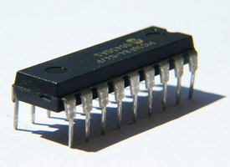

The Four USNC CA System
Mirror Committees
USNC/IECEE
  Electrical equipment: safety and performance
USNC/IECEx
  Hazardous environments
USNC/IECEQ
  Electronic components
USNC/IECRE
  Renewable energies

Slide 24
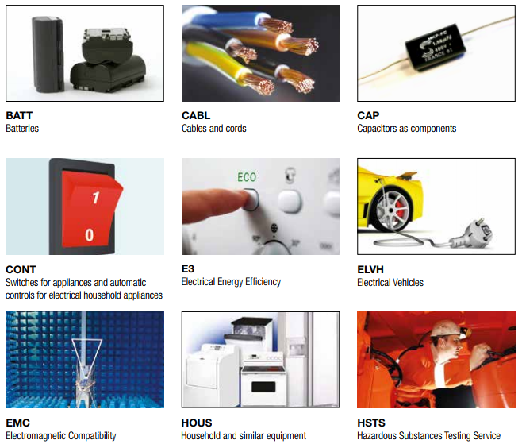
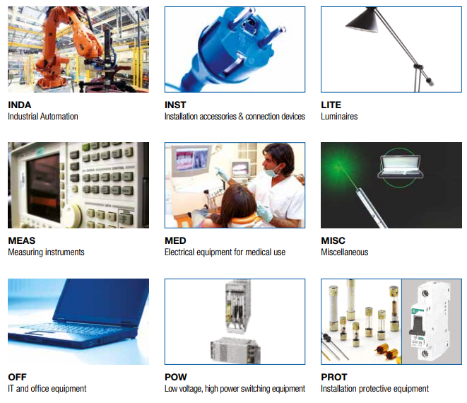
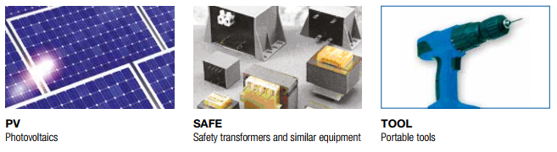

USNC/IECEE Certification Services

Slide 25
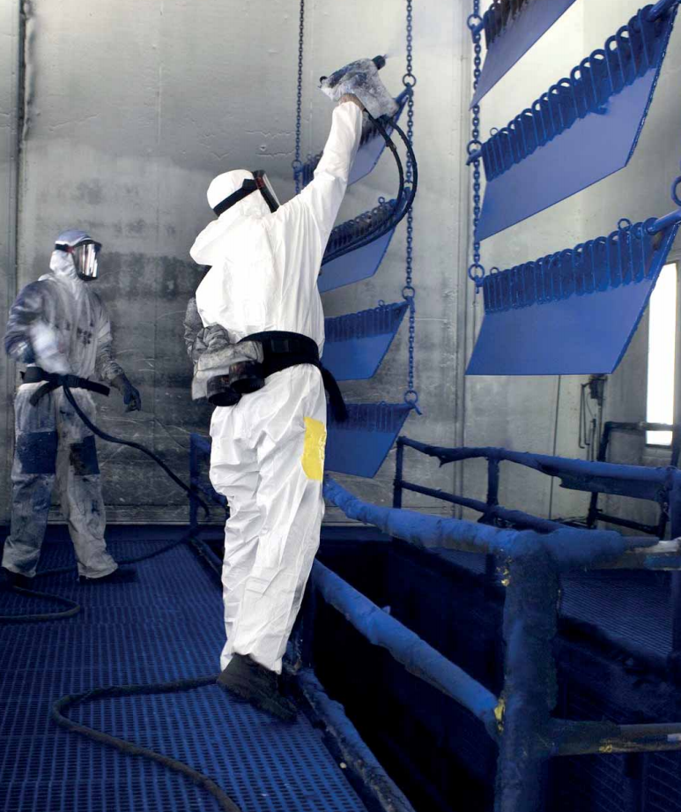
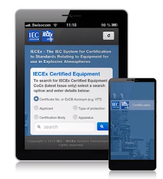
USNC/IECEx Certification Services
IECEx Certified Equipment Scheme
IECEx Certified Service Facilities Scheme
IECEx Certification of Personnel Competencies
IECEx Certified Mark Licensing System
IECEx Mobile App

Slide 26

USNC/IECQ Certification Services
IECQ AP - Approved Process Scheme
  Certification of sub-processes for component manufacture
IECQ AC - Approved Components Scheme
  Certification of components, products, materials, &
  assemblies
IECQ AQP - Automotive Qualification Program
IECQ LED - Scheme for LED Lighting
IECQ ADHP – Avionic, Defense, & High Performance Scheme
IECQ CAP – Counterfeit Avoidance Program
IECQ HSPM – Hazardous Substances Process Mgmt. Scheme

Slide 27

IECRE Certification Services
IECRE System is organized into
three Sectors:
  Marine Energy
  Wind Energy
  Solar PV Energy
Each of these sectors will be able to operate Schemes that cover
  products, e.g. components and systems
  services, e.g. installations and other related offers of the sector
  personnel, e.g. covering the competence of those working in the sector

Slide 28
Technical Management
Committee (TMC)
The USNC Technical Management Committee is responsible for ensuring the proper and expeditious development of technical work
The TMC is comprised of not more than twenty-one (21) individuals
  TMC members are proposed by the USNC voting members
  Elected by USNC Council

Slide 29

Members of the TMC Responsibilities
Developing US positions before the IEC SMB and other regional/international bodies;
Approving designations of Technical Advisors (TAs), Deputy Technical Advisors (DTAs), and TAG Administrators;
Approving designations of Secretaries and Assistant Secretaries of US Secretariats of IEC Committees;
Approving nominations of US Chairs for IEC TCs/SCs/Systems Committees (SyCs);
Authorizing invitations to host TC/SC meetings in the US;
Designating TAGs for each IEC technical committee and subcommittee in which the US elects to participate;
Establishing, as appropriate,
committees to cover US participation in SMB activities;
Reviewing and voting on all recommendations to surrender a Secretariat of an IEC Committee;
Coordinating with USNC CAPCC to resolve any standards technical issues;
Approving TAG Operating Procedures;
Reporting to USNC Council after each meeting.

Slide 30

Technical Advisory Groups (TAGs)
For each IEC TC and SC on which the USNC is a “P” (Participating) there shall be a U.S. Technical Advisory Group or TAG.
For additional information on USNC TAGs, please see Module 2-B of this USNC training program

Slide 31

TMC Member – Technical Advisor (TA)
Single point of technical contact for a
USNC TAG appointed by the Technical Management Committee (TMC). The TA often serves as Chairman of the TAG.
A TA shall be appointed for a four (4) year term of office by the USNC Technical Management Committee (TMC) for each IEC TC and SC on which the USNC elects to be a participating (“P”) member. A TA shall be nominated by the responsible Group Manager (GM) to the TMC for its approval, on recommendation from the related TAG.

Slide 32
Technical Advisor Qualifications
The following are essential attributes that make somebody
suitable for appointment to a TA or DTA (Deputy Technical Advisor) position:
  technical expertise in the subject area
  knowledge of and recognition by the concerned part(s) of the U.S. industry sector
  negotiating skills
  financial and administrative support for travel and activities
  ability to conduct business electronically
  understanding of the IEC standards development process
  full membership in the TAG

Slide 33
Technical Advisor Responsibilities
Helps to obtain nominees for U.S. Experts to participate on WGs
Arranges for existing U.S. national standards to be used as initial discussion drafts (as appropriate and with authorization)
Advocates the adoption and/or adaptation of IEC standards by U.S. standards developers, when desired by the cognizant industrial sector
Maintains liaison with other USNC TAs
Anticipates future programs of
TC/SC and IEC organizational changes that provide opportunities for U.S. leadership or influence
Provides for the continuity of U.S. participation and an assurance that U.S. consensus positions are developed and well represented
Informs GMs of TC/SC work
  immediately raises any topics of interest or concern
  provides annual reports

Slide 34

TAG Chair Responsibilities
The TA may serve as the
Chair of a U.S. TAG
A Chair may also be appointed by the TA from the individual members of the TAG, subject to approval by a majority vote of the TAG

Slide 35

Deputy Technical Advisor (DTA)
One or more Deputy Technical Advisors (DTA) may
be appointed by the USNC TMC
  Responsibilities
    Works in concurrence with the TA / TAG Administrator
    May attend meetings of the USNC TMC and participate as appropriate
  Appointment Process and Term of Office
    Term of office concurrent with TA

Slide 36

TAG Administrator
Organization that is assigned by the Technical Management Committee to provide administrative support for a TAG for a 4 year period.
The TAG Administrator shall appoint a TAG Secretary, an individual who is responsible for the day-to-day administration of the TAG.

Slide 37

TAG Secretary
Individual who is assigned by a TAG Administrator to provide day-to-day administrative support for a TAG.
Neither the TAG Administrator nor the TAG Secretary has veto power over the decisions of the TAG.

Slide 38
TAG Secretary Responsibilities
Supports Technical Advisor (TA) in management of TAG with
TAG meetings, document management and distribution, records, rosters, minutes and voting results
  Supports the TA in organizing and maintaining the TAG
  Provides for administrative services, including arrangements for TAG meetings, document distribution and record keeping, preparations of minutes and voting results, etc.
  Transmits U.S. positions on relevant IEC TC/SC issues and votes to the USNC Office
  Works to maintain the viability of the USNC TAG Participation Fee program

Slide 39
Group Manager (GM)
Each member of the TMC is assigned as Group Manager to a selection of USNC TAGS. The GM:
  Serves as a liaison between the TAGs and the TMC
  Provides general direction for USNC participation in assigned TAGs
  Provides overall guidance and assistance to the assigned TAs/DTAs, TAG Administrators and TAGs
  Monitors and gives assistance for all assigned USNC Secretariats
  Offers recommendations for TAs, U.S. Chairs and Secretaries of IEC committees
  Helps to resolve problems, conflicts and appeals that may arise
  Provides coordination contact for other GMs and their assigned TAGs

Slide 40

TAG Members
Any U. S. national interested parties directly
and materially affected by the work of the TC/SC may participate as members of a USNC-approved TAG
  The process for developing USNC positions provide an opportunity for fair and equitable participation without dominance by any single interest
  At least three (3) voting members are required for viability of the TAG
  An annual TAG participation fee of $295 is required
  All appointed USNC Experts are considered participating members of their related TAG

Slide 41
WG, PT or MT Experts Responsibilities
Working Group (WG), Project Team (PT) or Maintenance Team (MT) experts are individual subject matter experts who are encouraged to promote the position of their respective national committees within the discussions of an IEC group
  U.S. experts are appointed for their individual expertise, not as representatives of USNC positions
  These experts are encouraged, however, to work closely with the related U.S. TAGs so that consistent positions will be taken when official voting is required

Slide 42
USNC Constituent Training Program
Module III-B
Complete

